Slide 1
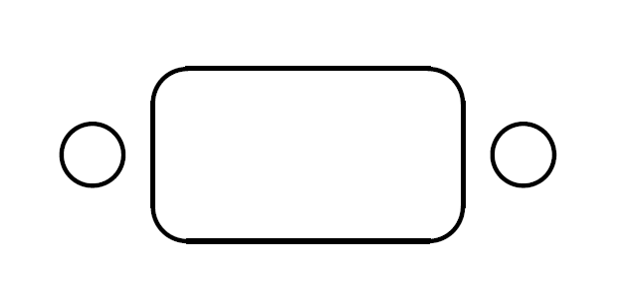
ø3.6mm holes must be countersunk to a depth of 1.2mm and a diameter of 5.7mm
Front view
(Overall thickness measured to be ~2.8mm)
(Panel exterior face)
1.2mm
ø5.7mm
Side view of individual hole
ø3.6mm
(Panel interior face)

